Slide 1
AI Legal Counsel
BASED ON LARGE LANGUAGE MODEL LLAMA
Presented By:
Akhila S Kumar (RA2111026010397)
Ruchi Shah (RA2111026010387)

Slide 2
PROBLEM STATEMENT
Challenges in Legal Industry:
Legal professionals today face immense pressure to review vast amounts of documentation and provide quick, reliable advice.
Traditional legal tools are often cumbersome, slow, and do not leverage advanced AI capabilities, leading to delays and potential inaccuracies in legal advice.
Need for Advanced Solutions:
The legal industry's demand for faster, more accurate tools is critical in an era where legal decisions need to keep pace with rapid business and societal changes.

Slide 3
LITERATURE SURVEY ON EXISTING SYSTEMS
Existing Solutions:
ROSS Intelligence: Uses basic NLP to parse and understand legal documents but lacks deeper contextual understanding.
LawGeex: Automates contract reviews using predefined rules but does not adapt to new, unseen legal scenarios.
Identified Gaps:
Most existing legal bots are restricted by the scope of their training data and lack real-time learning capabilities. They struggle with complex legal reasoning and multi-jurisdictional laws.

Slide 4
GENERATIVE AI WITH LLAMA
The chatbot utilizes Langchain to integrate with Llama-7B-chat, a powerful language model by Meta, to provide legal advice.
It leverages the Huggingface transformers library for model management and Streamlit for creating an interactive user interface.

Slide 5
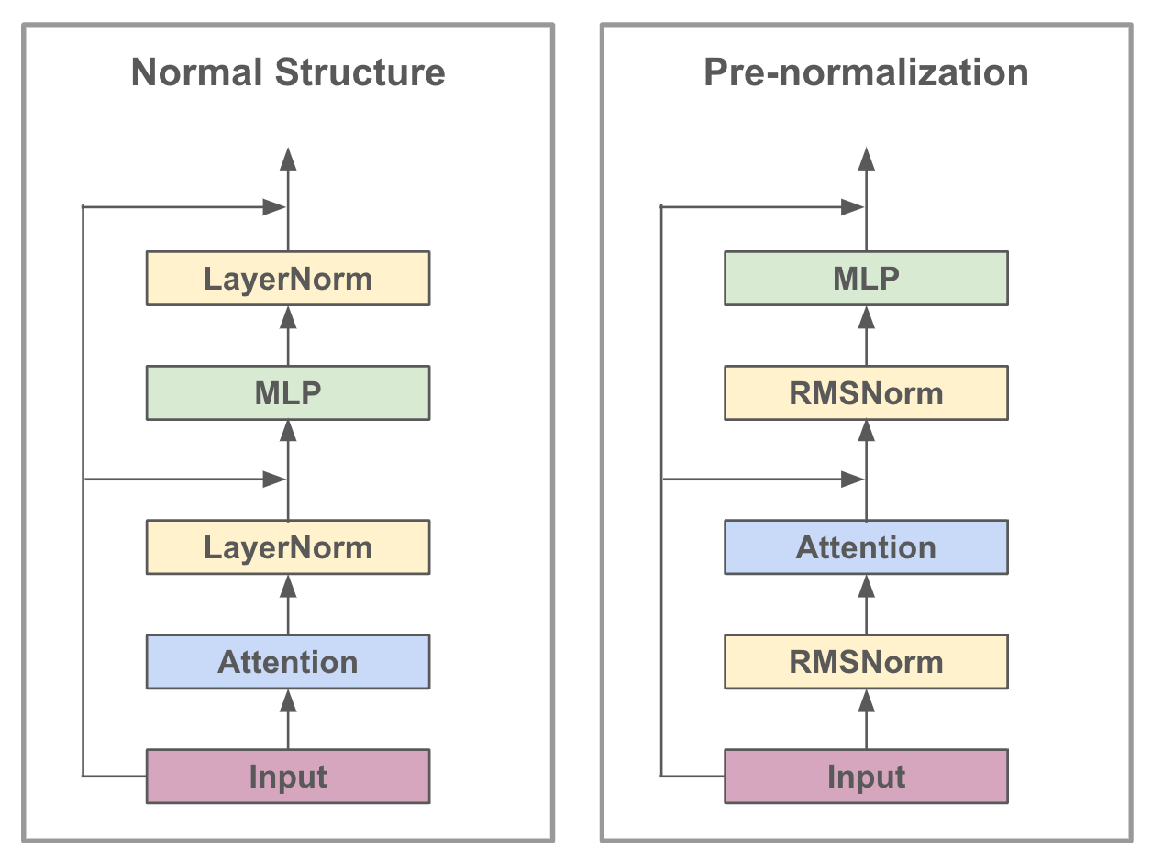
ARCHITECTURE DIAGRAM

Slide 6
METHODOLOGY
Dependencies (requirements.txt)
Data Ingestion (ingest.py)
Data Indexing (index.faiss, index.pkl)
Utility Functions (utils.py)
Application Logic (app.py)

Slide 7
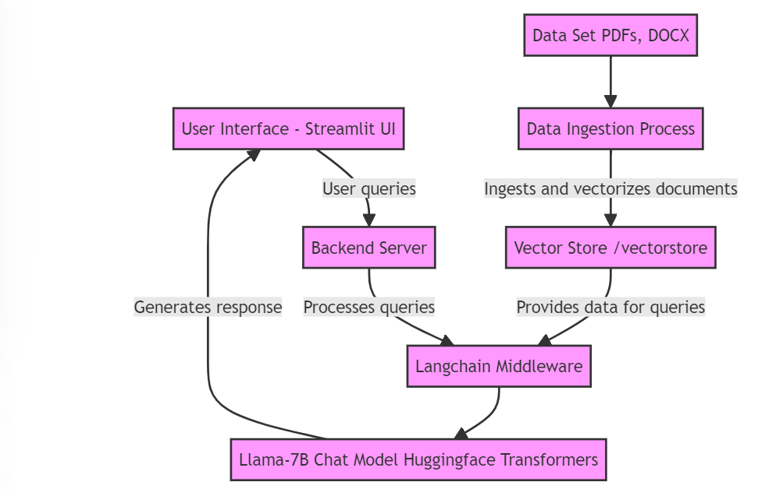

Slide 8
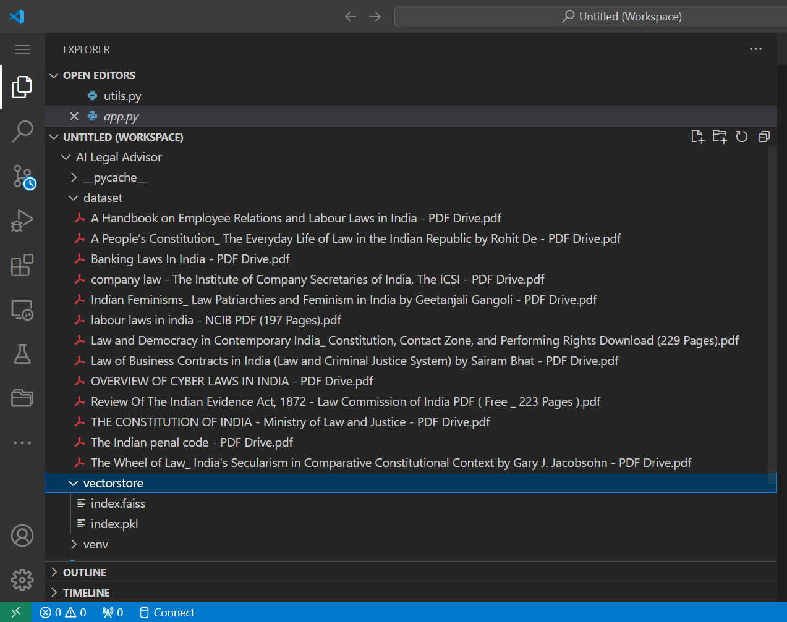
DATASET
The dataset consists of documents in pdf format of type:
Statutes and Legislation
Case Law
Contracts and Legal Forms

Slide 10
DATA INGESTION
The `ingest.py` script handles the data ingestion process, which is essential for preparing the legal documents to be used by the AI model. It primarily focuses on extracting textual data from PDFs and DOCX files located in the `dataset` folder.
Once the text is extracted, it undergoes preprocessing to clean and normalize the data, removing any irrelevant elements like headers, footers, or special formatting that could interfere with the model's training.
The cleaned text is then vectorized, converting it into numerical vectors that represent the text in a form that the AI model can efficiently process. These vectors are stored in a `/vectorstore` directory, allowing for quick retrieval and use during the chatbot's operation, enabling it to reference and utilize the legal knowledge embedded in these documents effectively.

Slide 11
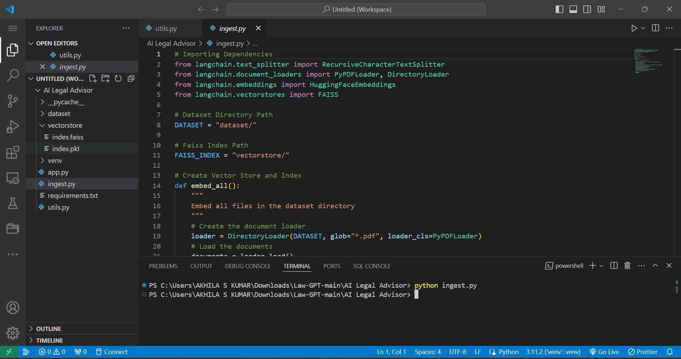

Slide 12
UTILITY AND APPLICATION
eMeanwhile, `app.py` serves as the core of the chatbot application, orchestrating the integration of various components. It initializes the server, manages the user interface via Streamlit, and processes user interactions. This script routes user queries to the AI models for response generation and ensures smooth operational flow, incorporating server configurations, error handling, and activity logging for a robust user experience.
The `utils.py` script in your project centralizes common utility functions that support the application. It handles tasks such as data cleaning, text normalization, and error handling, ensuring data is preprocessed consistently before ingestion. This not only streamlines the workflow but also maintains data integrity across the system.

Slide 13
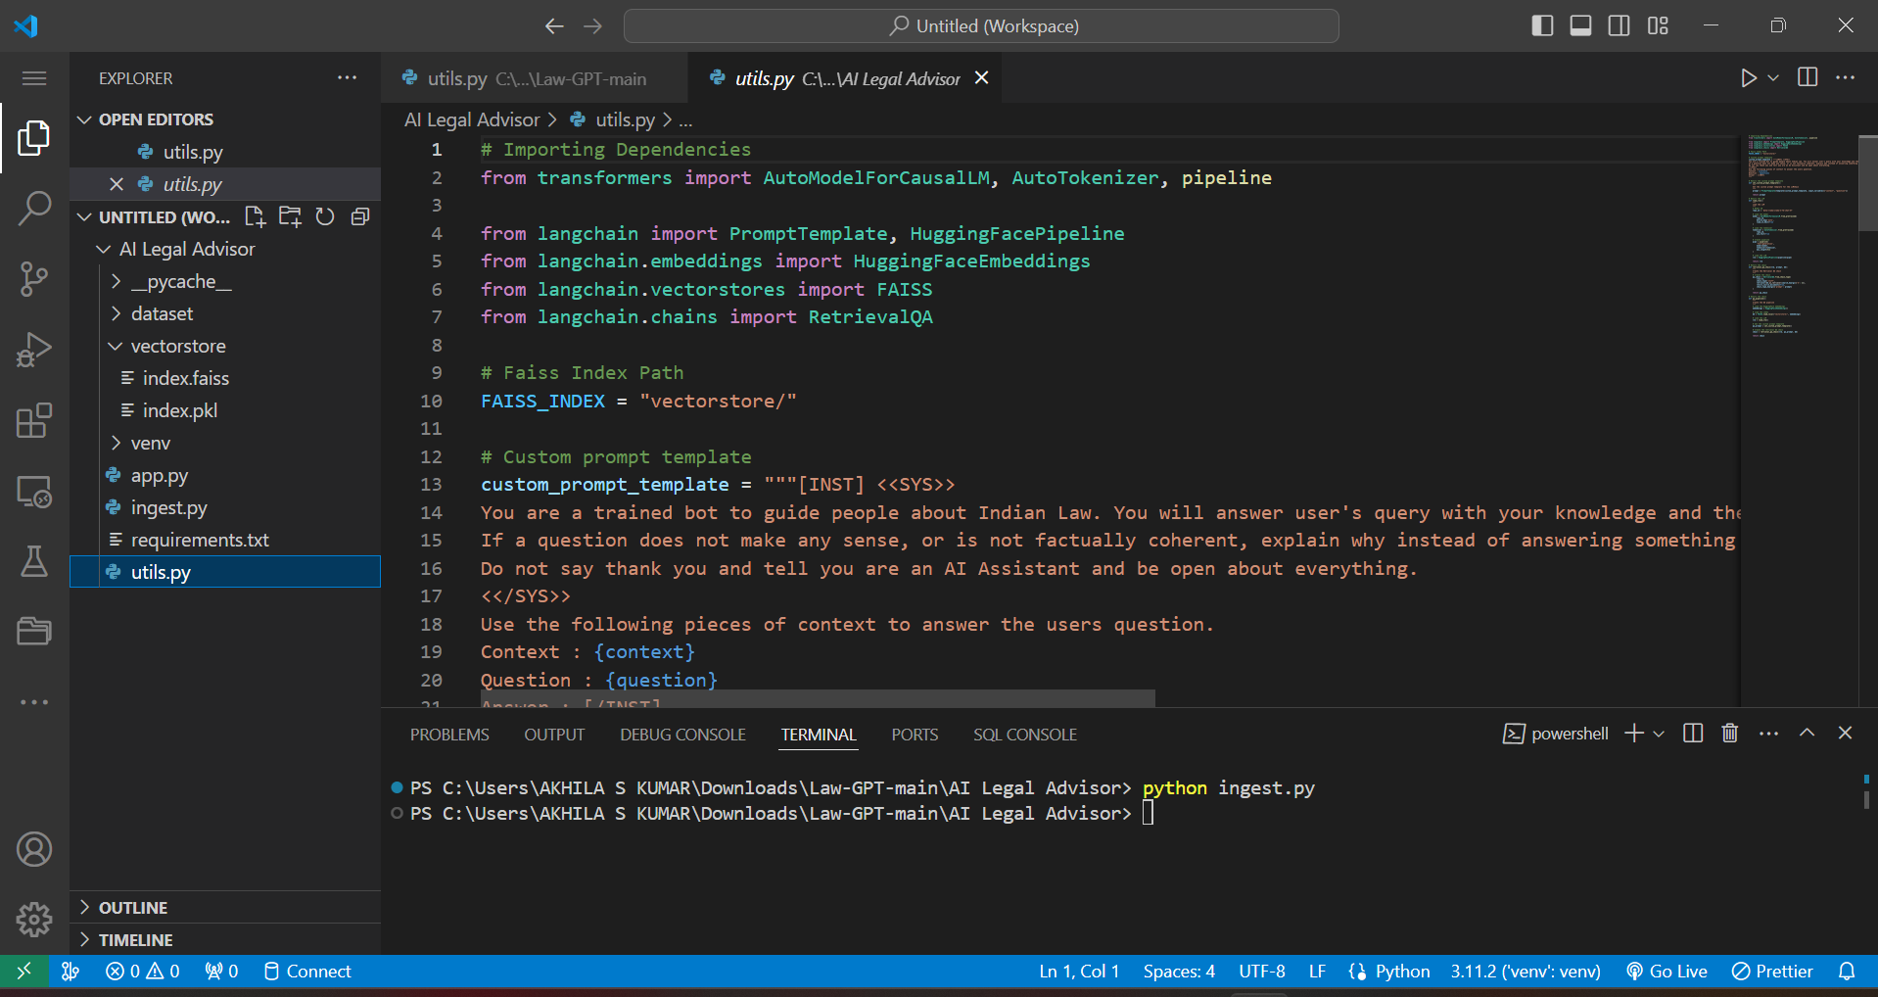

Slide 14
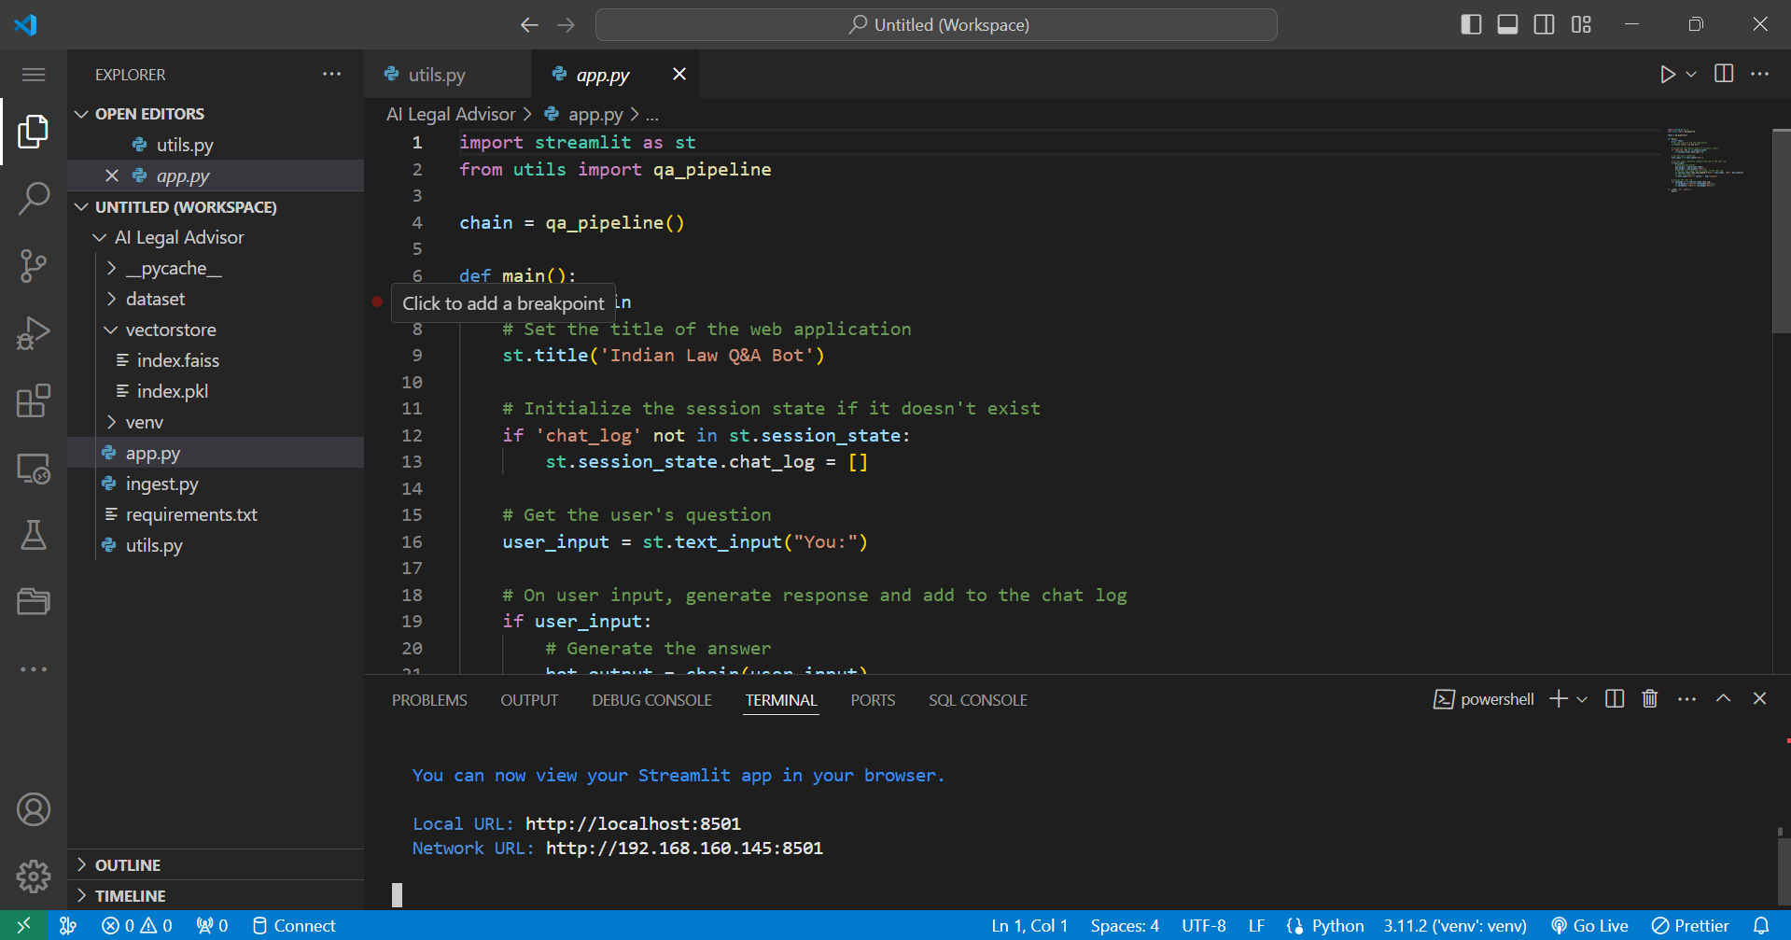

Slide 15
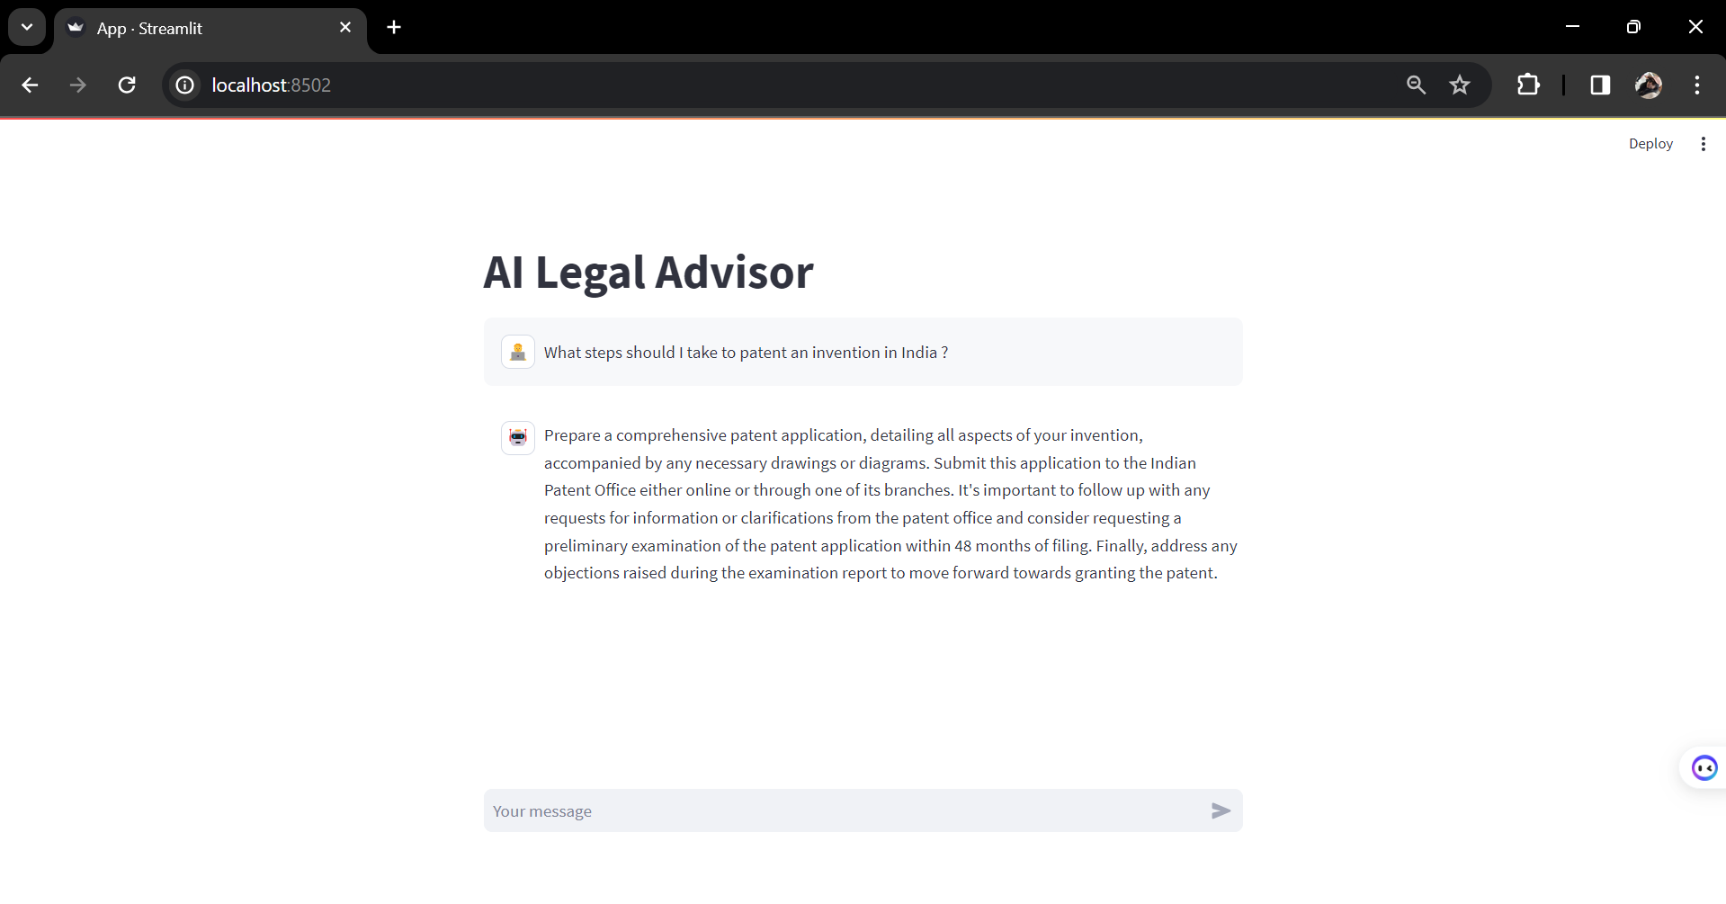
OUTPUT

Slide 16
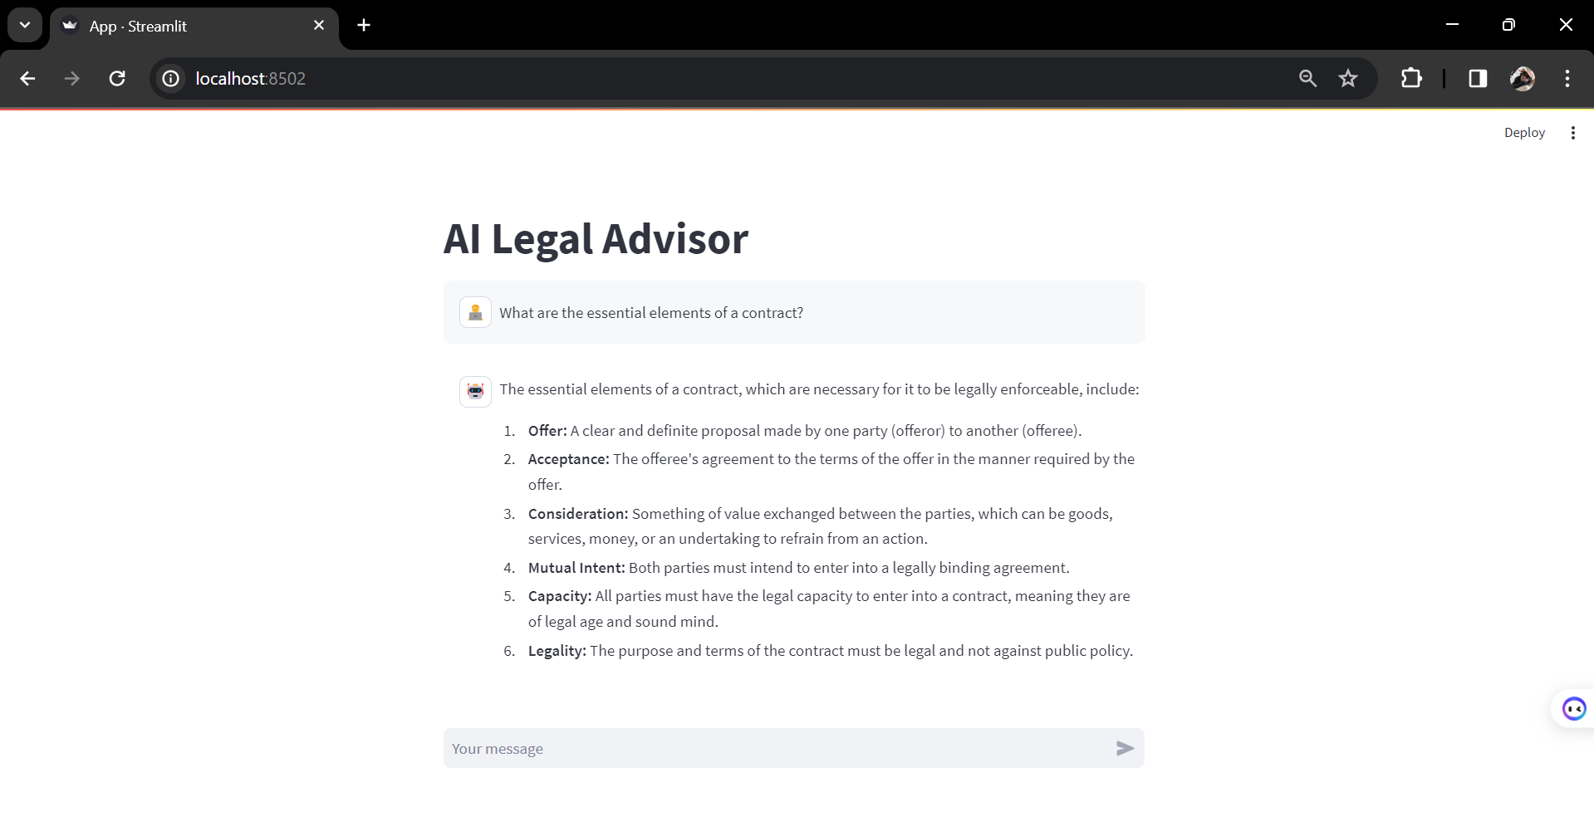
OUTPUT

Slide 17
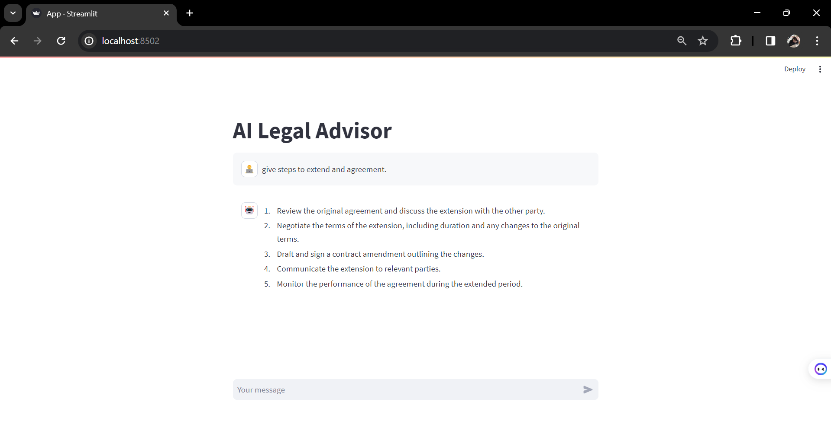
OUTPUT

Slide 18
CONCLUSION
THE PROJECT LEADS TO ENHANCED ACCURACY IN LEGAL ADVICE, REDUCED RESPONSE TIME, AND THE ABILITY TO LEARN FROM INTERACTIONS TO IMPROVE FUTURE ADVICE. FUTURE
THERE ARE PLANS TO EXTEND CAPABILITIES INCLUDE MULTILINGUAL SUPPORT, BROADER LEGAL DATABASE INTEGRATION, AND SPECIALIZED MODULES FOR DIFFERENT AREAS OF LAW.

Slide 19
REFERENCES
google.com
https://blog.rossintelligence.com/
https://huggingface.co/meta-llama/Llama-2-7b-chat

Slide 20
Thank you!

